Slide 1
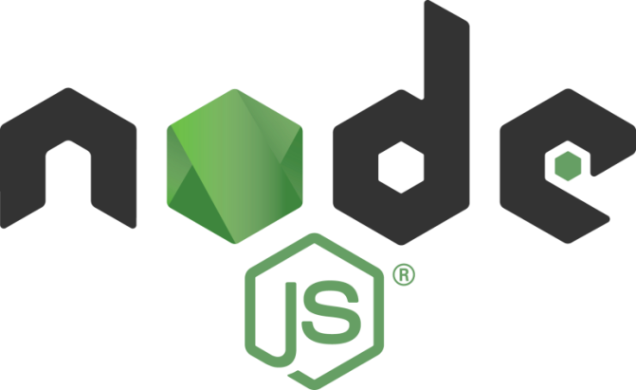
Exploring
#4 Node Package Manager

Slide 2

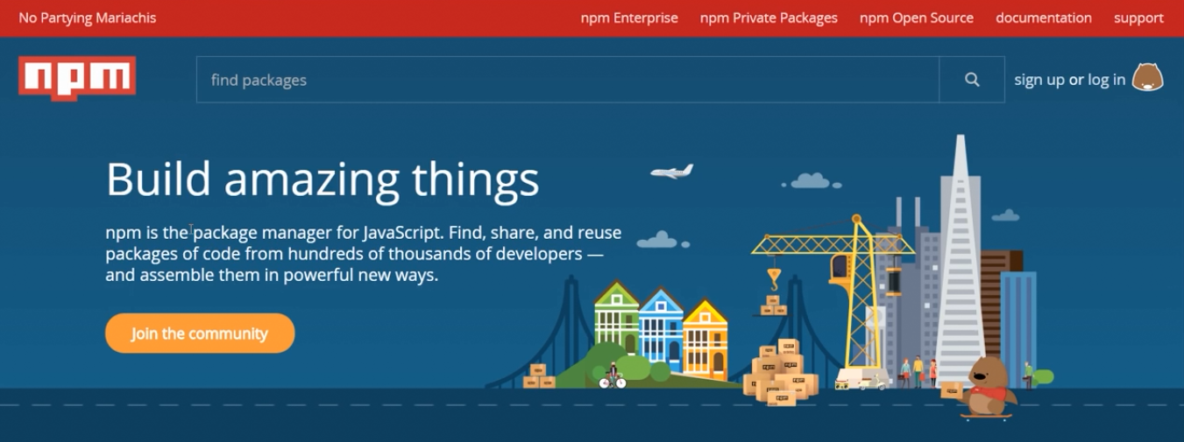
Node Package Manager
NPM is the package manager for JavaScript. Basically it’s just a bunch of tools which will help the developers to use 3rd party packages/modules, for building their application easily.
npmjs.com

Slide 3
Package
Package is a file/directory that is described by a package.json, including:
A folder containing a program described by a package.json file,
A gzipped tarball containing (1.),
A url that resolves to (2.),
A <name>@<version> that is published on the registry with (3.),
A <name>@<tag> that points to (4.),
A <name> that has latest tag satisfying (5.),
A git url that, when cloned, results in (1.).

Slide 4
Modules
Module is anything that can be loaded with require() in an NodeJS program, including:
A folder with a package.json file containing a main field,
A folder with an index.js file in it, or
Just a JavaScript file.
Note: Most NPM packages are modules!

Slide 5
NPM Packages/Modules
NPM has hundreds of packages/modules
which you can use easily.
angular
bluebird
body-parser
chalk
commander
config
express
ejs
jest
jshint
lodash
lru-cache
meddleware
nodemon
node-static
nodeUtils
path
pluralize
request
serve-favicon
table
typescript
etc...

Slide 6
Getting Started
On terminal (at your dir project), type:
npm -v
check the version of installed npm.
npm init
set package, make a package.json file.
package.json is a JSON file that contains
lot of informations about our app & keeps
track which package/modules we used.
* similar to our medical records, right? :)
npm install namaPackage --save
install an NPM package/module (npm i).
npm install
install packages that written in package.json

Slide 7
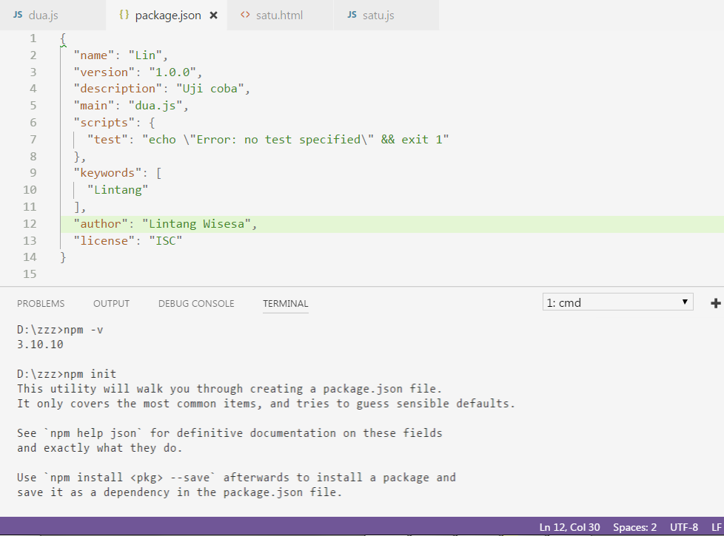
package.json

Slide 8

Chalk
Install Chalk
npm install chalk
Install chalk & update package.json
npm install chalk --save
More info: github.com/chalk/chalk

Slide 9

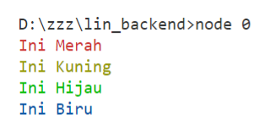
Chalk
#1 Base Color
const chalk = require('chalk');
console.log(chalk.red('Ini Merah'));
console.log(chalk.yellow('Ini Kuning'));
console.log(chalk.green('Ini Hijau'));
console.log(chalk.blue('Ini Biru'));

Slide 10
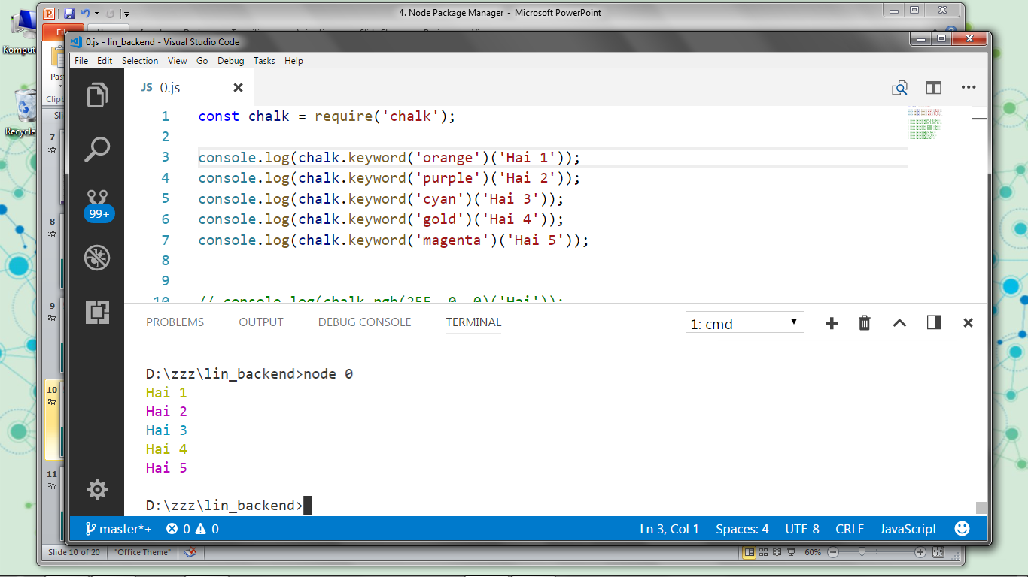
Chalk
#2 Keyword
const chalk = require('chalk');
console.log(chalk.keyword('orange')('Hai 1'));
console.log(chalk.keyword('purple')('Hai 2'));
console.log(chalk.keyword('cyan')('Hai 3'));
console.log(chalk.keyword('gold')('Hai 4'));
console.log(chalk.keyword('magenta')('Hai 5'));

Slide 11
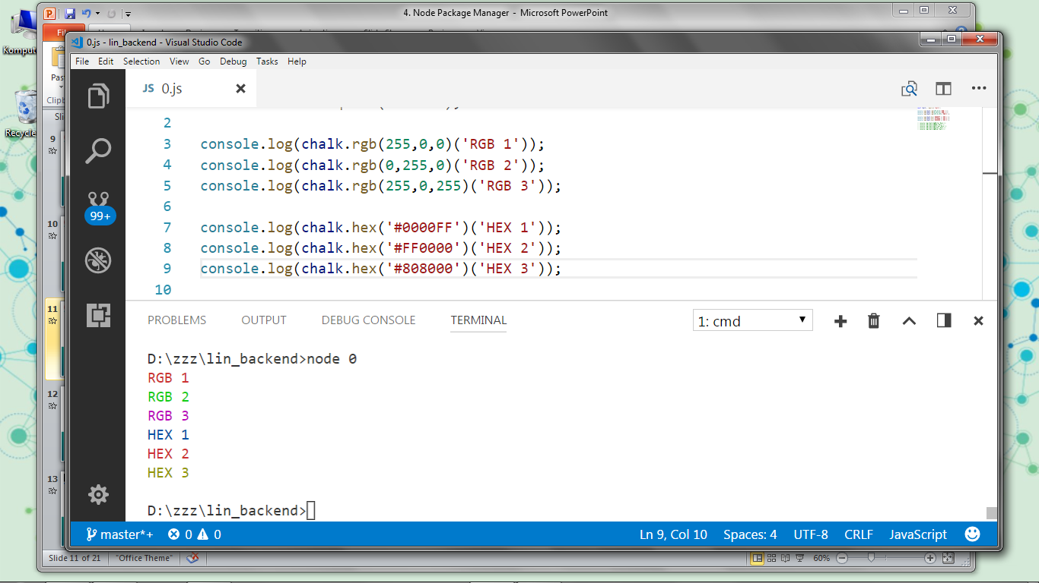
Chalk
#3 RGB & HEX
const chalk = require('chalk'); console.log(chalk.rgb(255,0,0)('RGB 1'));
console.log(chalk.rgb(0,255,0)('RGB 2'));
console.log(chalk.rgb(255,0,255)('RGB 3')); console.log(chalk.hex('#0000FF')('HEX 1'));
console.log(chalk.hex('#FF0000')('HEX 2'));
console.log(chalk.hex('#808000')('HEX 3'));

Slide 12
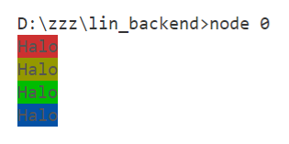
Chalk
#4 bgColor
const chalk = require('chalk');
console.log(chalk.bgRed('Halo'));
console.log(chalk.bgYellow('Halo'));
console.log(chalk.bgGreen('Halo'));
console.log(chalk.bgBlue('Halo'));

Slide 13
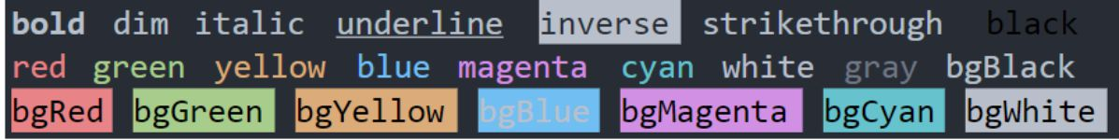
Colors
Install Colors
npm install colors
Install colors & update package.json
npm install colors --save
More info: npmjs.com/package/colors

Slide 14
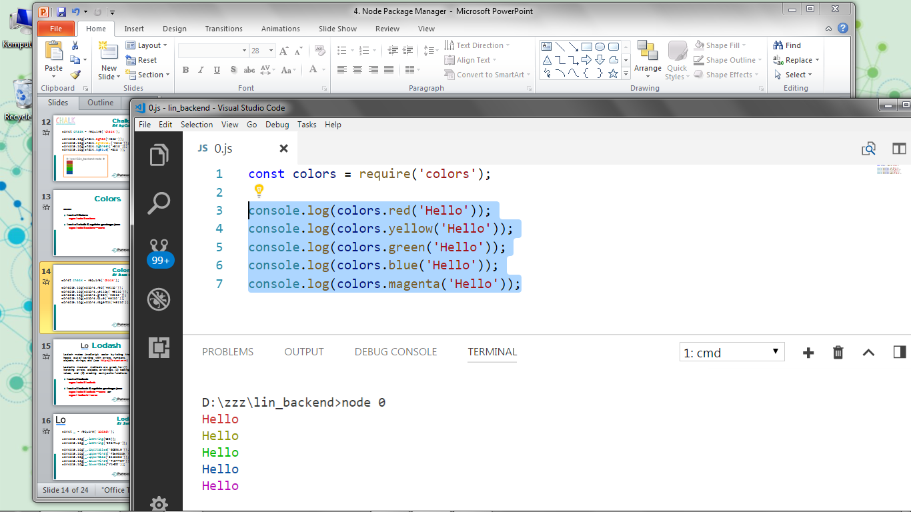
Colors
#1 Base Color
const colors = require('colors'); console.log(colors.red('Hello'));
console.log(colors.yellow('Hello'));
console.log(colors.green('Hello'));
console.log(colors.blue('Hello'));
console.log(colors.magenta('Hello'));
//black, cyan, white, gray, grey

Slide 15
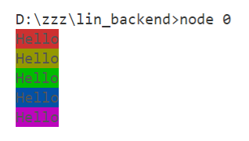
Colors
#2 bgColor
const colors = require('colors'); console.log(colors.bgRed('Hello'));
console.log(colors.bgYellow('Hello'));
console.log(colors.bgGreen('Hello'));
console.log(colors.bgBlue('Hello'));
console.log(colors.bgMagenta('Hello'));
//bgBlack, bgCyan, bgWhite

Slide 16
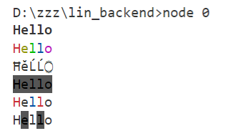
Colors
#3 Styles
const colors = require('colors'); console.log(colors.bold('Hello'));
console.log(colors.rainbow('Hello'));
console.log(colors.trap('Hello'));
console.log(colors.inverse('Hello'));
console.log(colors.america('Hello'));
console.log(colors.zebra('Hello'));

Slide 17
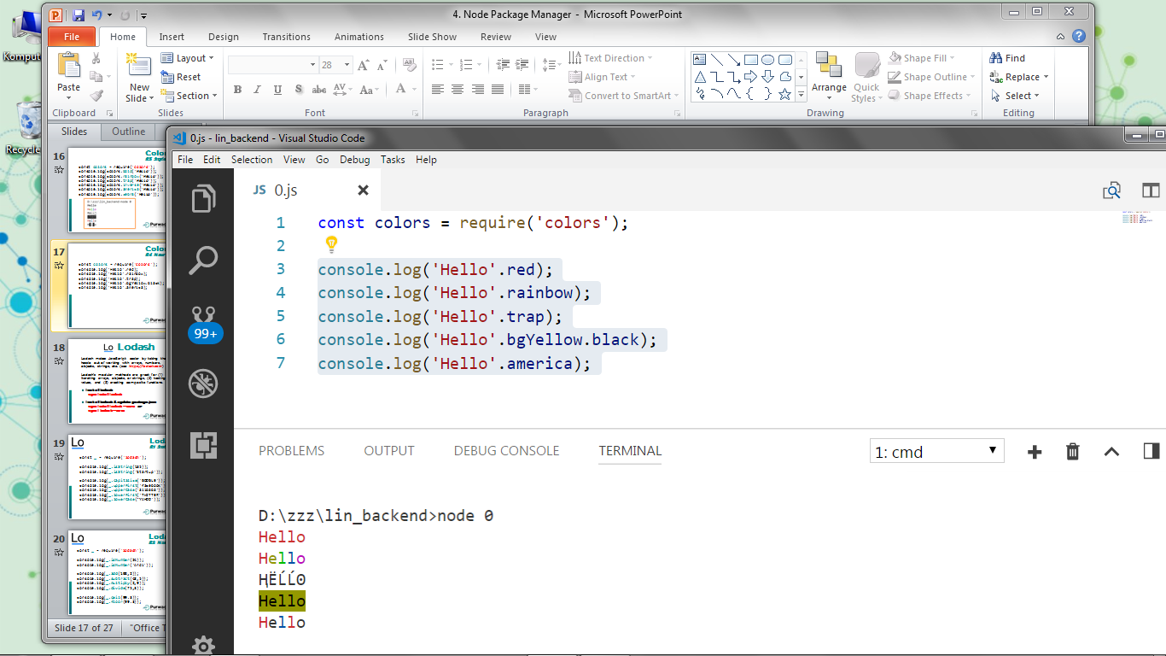
Colors
#4 New Way
const colors = require('colors'); console.log('Hello'.red);
console.log('Hello'.rainbow);
console.log('Hello'.trap);
console.log('Hello'.bgYellow.black);
console.log('Hello'.america);

Slide 18
Slug
It slugifies every string, even when it contains unicode! For short: make strings url-safe.
Install slug
npm install slug
Install it & update package.json
npm install slug --save

Slide 19
Slug
#1 Slug
var slug = require('slug');
var satu = slug('NodeJS ♥ is ☢');
var dua = slug('I <3 NodeJS');
console.log(satu)
console.log(dua)

Slide 20
Slug
#2 Edit
var slug = require('slug');
slug.charmap['♥'] = 'am crazy of'
var tiga = slug('i ♥ nodejs', '_');
var empat = slug('I ♥ NODEJS', {lowercase: false})
console.log(tiga)
console.log(empat)

Slide 21
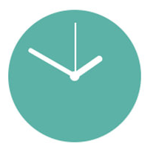
Moment
Moment is a NPM module to parse, validate, manipulate, and display dates and times in JavaScript. (see momentjs.com)
Install moment
npm install moment
Install moment & update package.json
npm install moment --save

Slide 22
Moment
#1 Now
const moment = require('moment');
var now1 = moment();
var now2 = moment().format();
var now3 = moment().format("ddd, hA");
var now4 = moment().format
("dddd, MMMM Do YYYY, h:mm:ss a");
console.log(now1);
console.log(now2);
console.log(now3);
console.log(now4);

Slide 23
Moment
#2 fromNow & toNow
const moment = require('moment');
var w = moment([2007]).fromNow();
var x = moment([2007, 0, 29]).fromNow(true);
var y = moment([2007]).toNow();
var z = moment([2007, 0, 29]).toNow(true);
console.log(w);
console.log(x);
console.log(y);
console.log(z);

Slide 24
Moment
#3 a-to-z
const moment = require('moment');
var a = moment([2007, 2, 27]);
var b = moment([2007, 0, 29]);
console.log(a.to(b));
console.log(a.to([2007, 1, 27]));
console.log(a.to(new Date(2007, 3, 6)));
console.log(a.to("2017-11-29"));

Slide 25

Lodash
Lodash makes JavaScript easier by taking the hassle out of working with arrays, numbers, objects, strings, etc. (see https://lodash.com)
Lodash’s modular methods are great for (1) iterating arrays, objects, or strings, (2) testing values, and (3) creating composite functions.
Install lodash
npm install lodash
Install lodash & update package.json
npm install lodash --save or
npm i lodash --save

Slide 26

Lodash
#1 String
const _ = require('lodash');
console.log(_.isString(135));
console.log(_.isString('Startup'));
console.log(_.capitalize('GOOGLE')); console.log(_.upperFirst('facebook'));
console.log(_.upperCase('alibaba')); console.log(_.lowerFirst('TWITTER'));
console.log(_.lowerCase('YAHOO'));

Slide 27
Lodash
#2 Number
const _ = require('lodash');
console.log(_.isNumber(24));
console.log(_.isNumber('Andi'));
console.log(_.add(100,2));
console.log(_.subtract(48,5));
console.log(_.multiply(2,9));
console.log(_.divide(75,3));
console.log(_.ceil(99.3));
console.log(_.floor(99.3));

Slide 28
Lodash
#3 Array
const _ = require('lodash'); var x = [1,3,2,4,3,5,4,6];
var y = ['Andi', 1, 'Budi', 2];
console.log(_.isArray(x));
console.log(_.uniq(x)); console.log(_.max(x));
console.log(_.min(y));
console.log(_.sum(x)); console.log(_.reverse(y));

Slide 29

Underscore
Install Underscore
npm install underscore
Install it & update package.json
npm install underscore --save
More info: npmjs.com/

Slide 30
Underscore
#1a Array Mapping
const _ = require('underscore');
var arr = [1, 2, 3]
var x = _.map(arr, function(num){
return num * 3;
});
console.log(x)

Slide 31
Underscore
#1b Array Mapping
const _ = require('underscore');
var x = [1,2,3]
var y = [4,5,6]
var z = [7,8,9]
var arr = [x, y, z]
var ok = _.map(arr, _.first);
console.log(ok)

Slide 32
Underscore
#2 Obj Mapping
const _ = require('underscore');
var obj = {a: 1, b: 2, c: 3}
var y = _.map(obj, function(num, key){
return num * 3;
});
console.log(y)

Slide 33
Underscore
#3 Arr Max & Min
const _ = require('underscore');
var arr = [1,2,3,4,5,6]
var nilaiMax = _.max(arr);
var nilaiMin = _.min(arr);
console.log(nilaiMax)
console.log(nilaiMin)

Slide 34
Underscore
#4 Obj Max & Min
const _ = require('underscore');
var pns = [
{nama:'Andi',usia:34},
{nama:'Budi',usia:40},
{nama:'Caca',usia:46}
]
var tertua = _.max(pns,(x)=>x.usia);
var termuda = _.min(pns,(x)=>x.usia);
console.log(tertua)
console.log(termuda)

Slide 35
Underscore
#5 Find & Filter
const _ = require('underscore');
var arr = [1,2,3,4,5,6]
function genap(x) {
return x % 2 == 0
}
var findGenap = _.find(arr, genap);
var filterGenap = _.filter(arr, genap);
console.log(findGenap)
console.log(filterGenap)

Slide 36

Yargs
Yargs helps you build interactive command line tools, by parsing arguments and generating an elegant user interface (See http://yargs.js.org).
It gives you:
commands and (grouped) options,
a dynamically generated help menu based on your arguments &
bash-completion shortcuts for commands and options.
Installation
npm install yargs --save

Slide 37

Yargs
Arg.vector
satu.js
var argv = require('yargs').argv;
console.log(argv.x , argv.y);
// Run script!
// node satu
// node satu --x=4 --y=4
// node satu -x 'Halo' -y 'kawan'

Slide 38
Yargs
Arg.vector
satu.js
const argv = require('yargs').argv console.log(argv.usia)
if (argv.usia>=25) {
console.log('Ingat umur, kak!')
} else {
console.log('Enjoy your life!')
}
// Run script!
// node satu
// node satu --usia=24
// node satu -usia 31

Slide 39
Yargs
process
satu.js
const argv = require('yargs').argv var perintah = process.argv;
console.log(perintah);
console.log(perintah[3]);
console.log(argv.judul);
// Run script!
// node satu
// node satu --judul=Iron Man
// node satu daftar --judul=Iron Man

Slide 40

Nodemon
Nodemon is a tool/utility that will monitor for any changes in your source and automatically restart your server. Just use nodemon instead of node to run your code, and now your process will automatically restart when your code changes.
See https://nodemon.io.
Installation
npm install -g nodemon
Open & run source with Nodemon
nodemon namaFile.js
Restart
rs

Slide 41

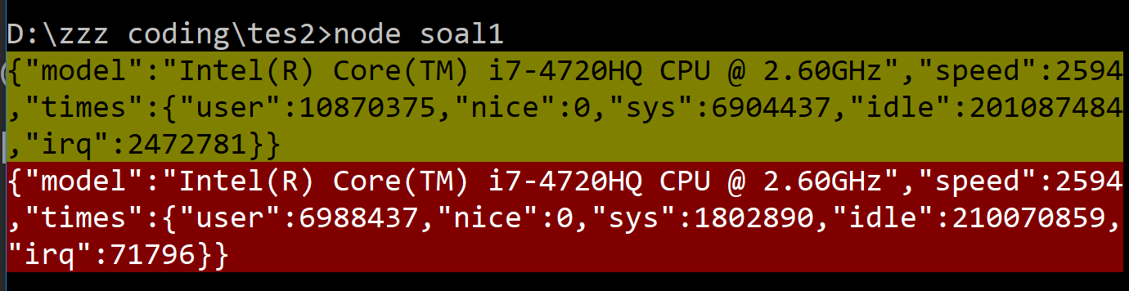

?
#1 Buatlah sebuah program yang saat dijalankan akan menampilkan data CPU user di console, dengan warna latar obj 1 kuning & obj 2 merah!
Gunakan module OS & Chalk!

Slide 42
#1 Solved!
const os = require('os');
const chalk = require('chalk')
var dataCPU0 = JSON.stringify(os.cpus()[0]);
var dataCPU1 = JSON.stringify(os.cpus()[1]);
console.log(
chalk.bgYellow.rgb(0,0,0)(dataCPU0));
console.log(
chalk.bgRed.rgb(255,255,255)(dataCPU1));

Slide 43
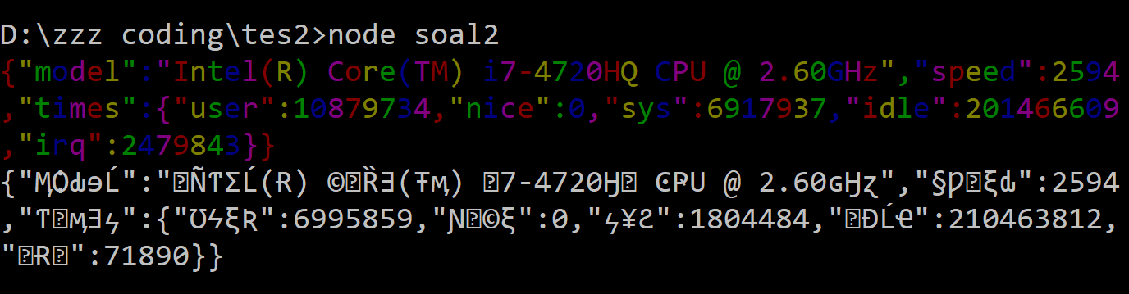
?
#2 Buatlah sebuah program yang saat dijalankan akan menampilkan data CPU user di console, dengan style
obj 1 rainbow & obj 2 trap!
Gunakan module OS & Colors!

Slide 44
#2 Solved!
const os = require('os');
const colors = require('colors')
var dataCPU0 = JSON.stringify(os.cpus()[0]);
var dataCPU1 = JSON.stringify(os.cpus()[1]);
console.log(colors.rainbow(dataCPU0));
console.log(colors.trap(dataCPU1));

Slide 45
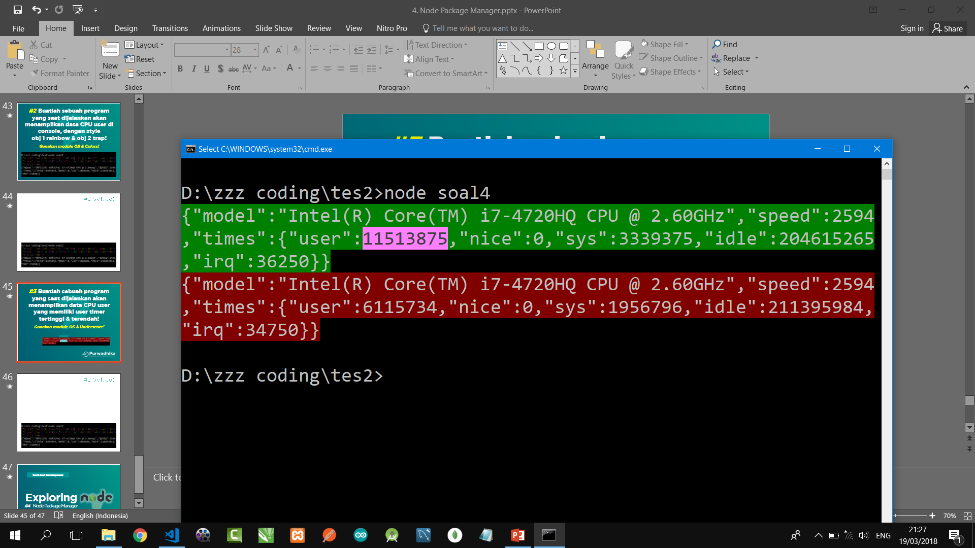
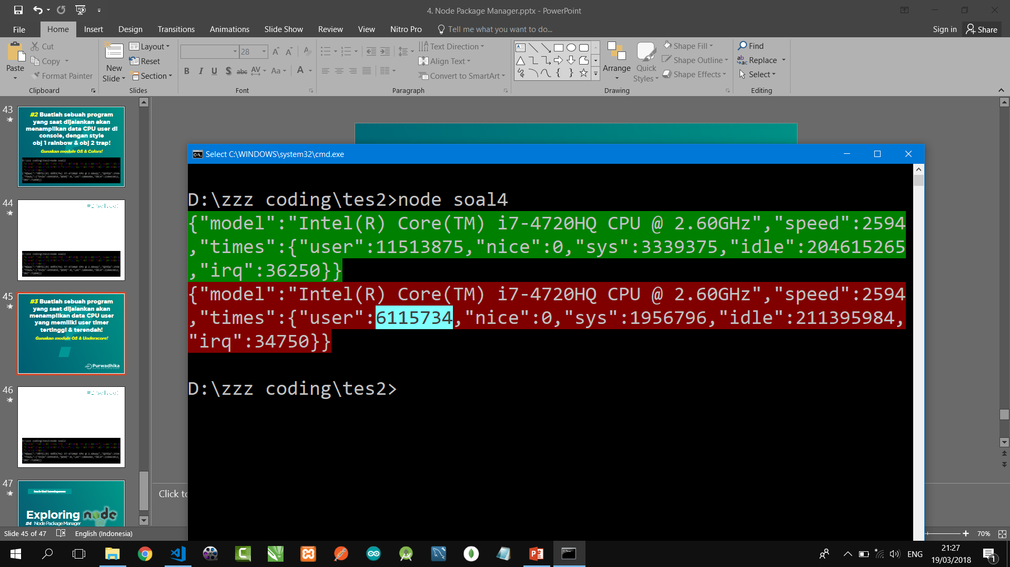
?
#3 Buatlah sebuah program yang saat dijalankan akan menampilkan data CPU user yang memiliki user times tertinggi & terendah!
Gunakan module OS & Underscore!

Slide 46
#3 Solved!
const colors = require('colors')
const os = require('os')
const _ = require('underscore');
var data = os.cpus();
var tertinggi = _.max(data,(x)=>x.times.user);
var terendah = _.min(data,(x)=>x.times.user);
console.log(colors.bgGreen(JSON.stringify(tertinggi)));
console.log(colors.bgRed(JSON.stringify(terendah)));

Slide 47
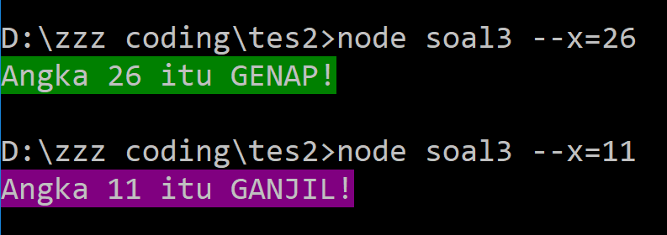
?
#4 Buatlah sebuah program yang saat dijalankan di terminal dengan parameter sebuah angka, dapat menentukan angka yang diinput user tersebut tergolong
genap atau ganjil!
Gunakan module Yargs!

Slide 48
#4 Solved!
const colors = require('colors')
const argv = require('yargs').argv
if (argv.x % 2 == 0) {
console.log
(colors.bgGreen(`Angka ${argv.x} itu GENAP!`))
}
else {
console.log
(colors.bgMagenta(`Angka ${argv.x} itu GANJIL!`))
}

Slide 49
Exploring
#4 Node Package Manager

